Slide 1
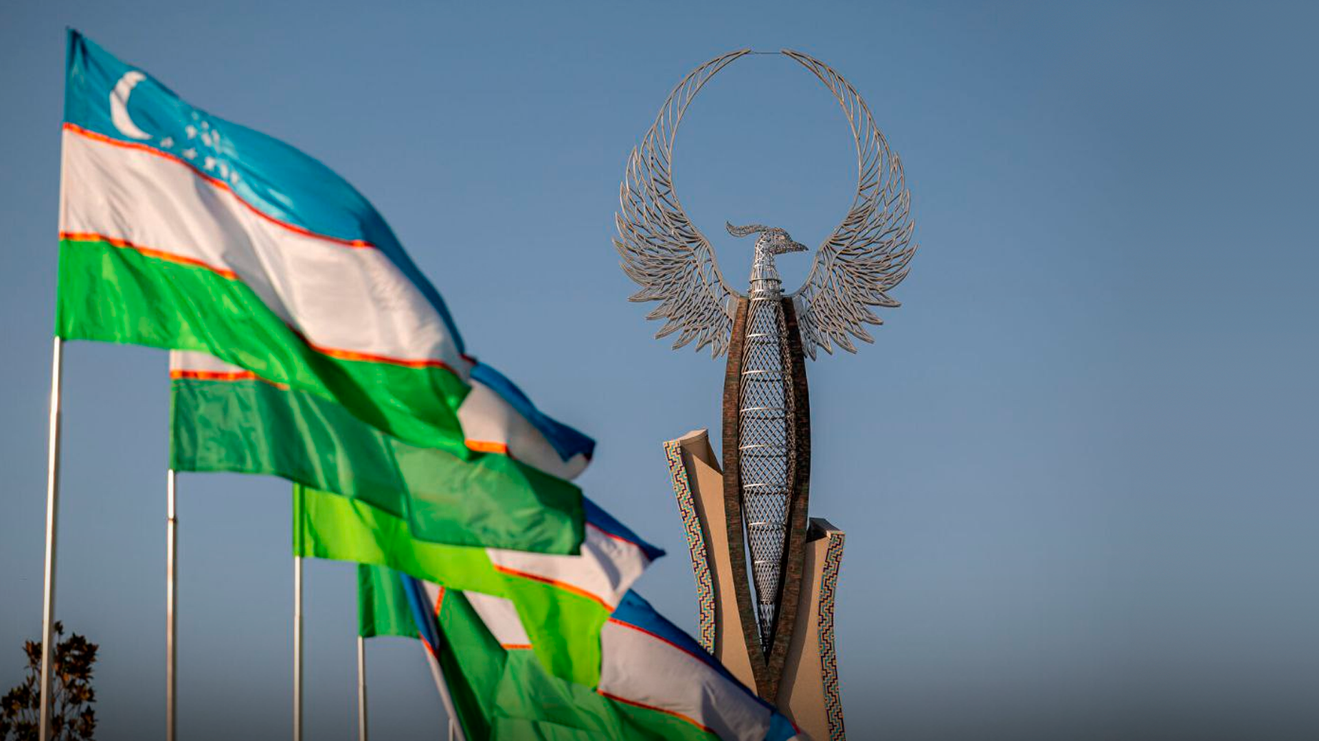

INVEST IN UZBEKISTAN

Slide 2





KEY DATA
448,9K km
11
Area
International Airports
A strategic position in the middle of Central Asia
36,1 Mln
~50%
East Asia +Southern Europe
Population
Urbanization rate
Through China, Kyrgyzstan and Uzbekistan

Slide 3
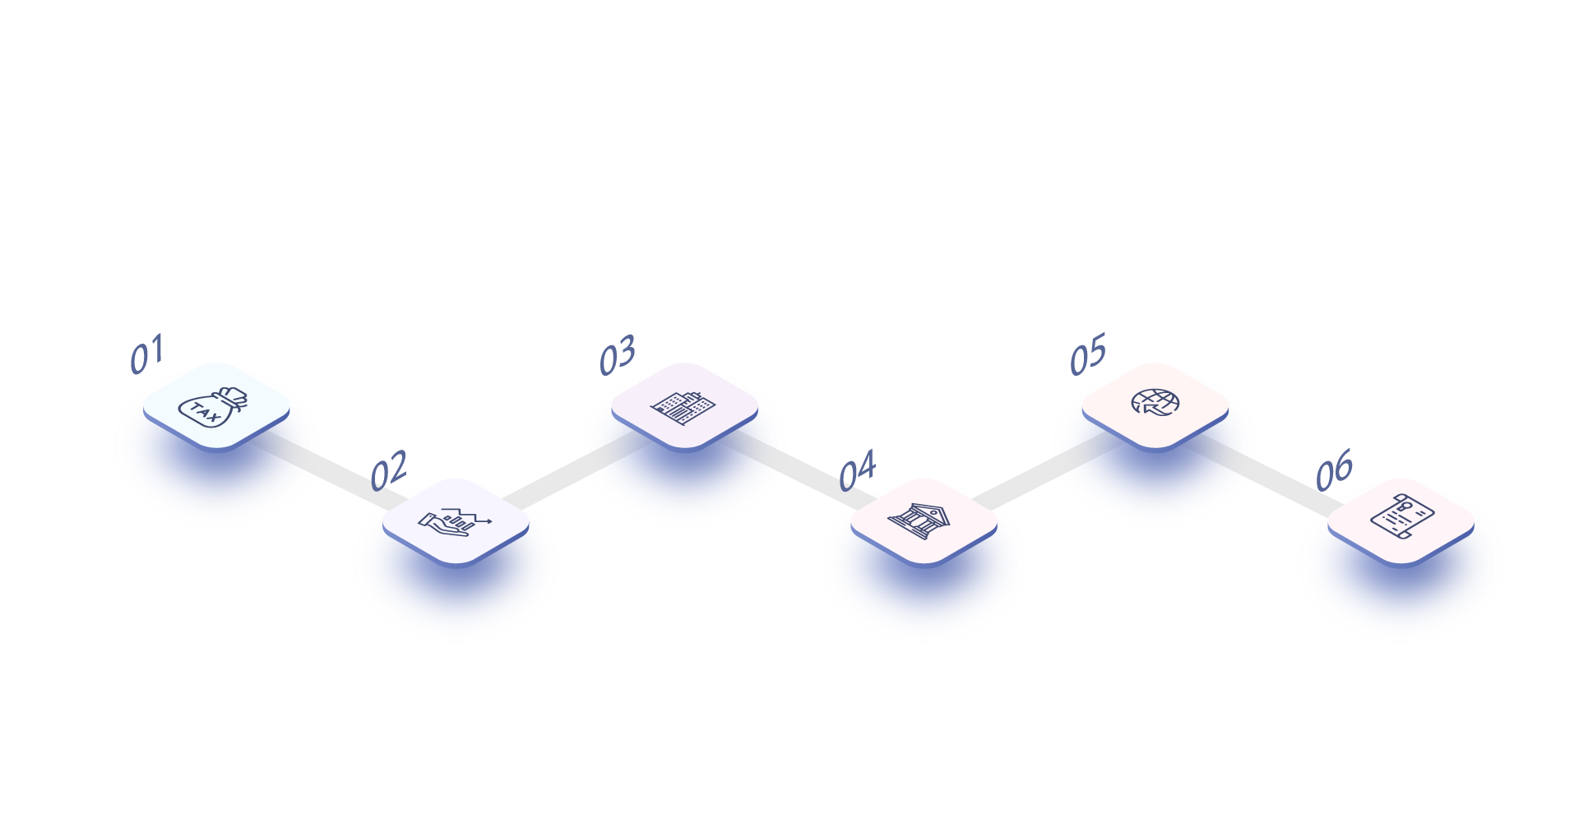
REFORMS OF PAST 7 YEARS
Foreign Investors Council
under the President
of the Republic
of Uzbekistan was established
500 functions of the Government on regulation of business were removed
132 licenses and permits were abolished
VAT rate was reduced from 20 % to 12 %
Process of registration of enterprises was improved
Import tariffs for more than 7 000 raw materials and goods were cancelled for investors

Slide 4




ECONOMIC GROWTH
GDP, current bln USD
FOREIGN TRADE TURNOVER, bln USD
62,1
80,4
26,6
50,0
2017
2022
2017
2022
INFLATION RATE, %
INDUSTRIAL PRODUCTION, bln USD
14,4
12,3
28,9
49,8
2017
2022
2017
2022

Slide 5







FDI LANDSCAPE
FDI SECTORAL STRUCTURE IN 2017 - 2022
FDI INFLOWS IN 2017 – 2022, mln USD
Manufacturing
26,2 %
Energy supply
Information
and communication
5,2 %
$35,7 bln
35,6 %
Mining
18,3%
Transportation
2,6%
14,9%
Other

Slide 6

Increasing GDP per capita by
1.6 times or up to
4 000 dollars
“Green economy” strategy
GOALS OF DEVELOPMENT STRATEGY FOR 2022-2026
Start of International Commercial Court’s activities
Expanding capital market from
$200 mln to $7 bln
Increasing the share of private sector in GDP to 80%, in exports to 60%
Investment projects for
$120 bln as well
as PPP projects
for $14 bln

Slide 7










COMPETITIVE HUMAN CAPITAL
ENROLMENT RATE
INTERNATIONAL
UNIVERSITIES
Pre-school
70%
209 higher educational institutions (HEIs)
School
100%
More than 1 mln students are studying in HEIs
HEI
38%

Slide 8








DEVELOPING INFRASTRUCTURE AND RESOURCES
DEVELOPING INFRASTRUCTURE
NATURAL RESOURCES
Resources | Rank in the world | Proven reserves
Gold | 10 | 184 mln oz
Natural Gas | 19 | 1,87 trln m
Copper | 10 | 44,7 mln t
Uranium | 16 | 139,2 thous. t
13,7K km
184K km
Total length of
gas pipelines
Total length
of roads
3
4,7K km
270K km
Total length of
railway system
Total length of
power lines

Slide 9



ACCESSIBLE MARKETS
GSP+ Enhanced Framework - Uzbek producers could export to the EU about 3,000 goods without charging customs duties and 3,200 items – at reduced rates.
448
Million in EU
300
783
MILLION
Million in CIS
CONSUMERS
Since Uzbekistan became GSP+ beneficiary, trade turnover with EU increased by 22%, while exports from Uzbekistan to the EU increased by 86%.
72
Million Central Asia
countries

Slide 10







COMPETITIVE BUSINESS COSTS
INDICATOR
PRICE
TAXATION
RATE
Electricity,
$ per 1 kWh
0,06
Personal income tax
12%(flat)
Water,
$ per m³
0,06
Tax on profit
15%
Natural gas,
$ per m³
0,12
Value
added tax
352
12%
Wage, $

Slide 11

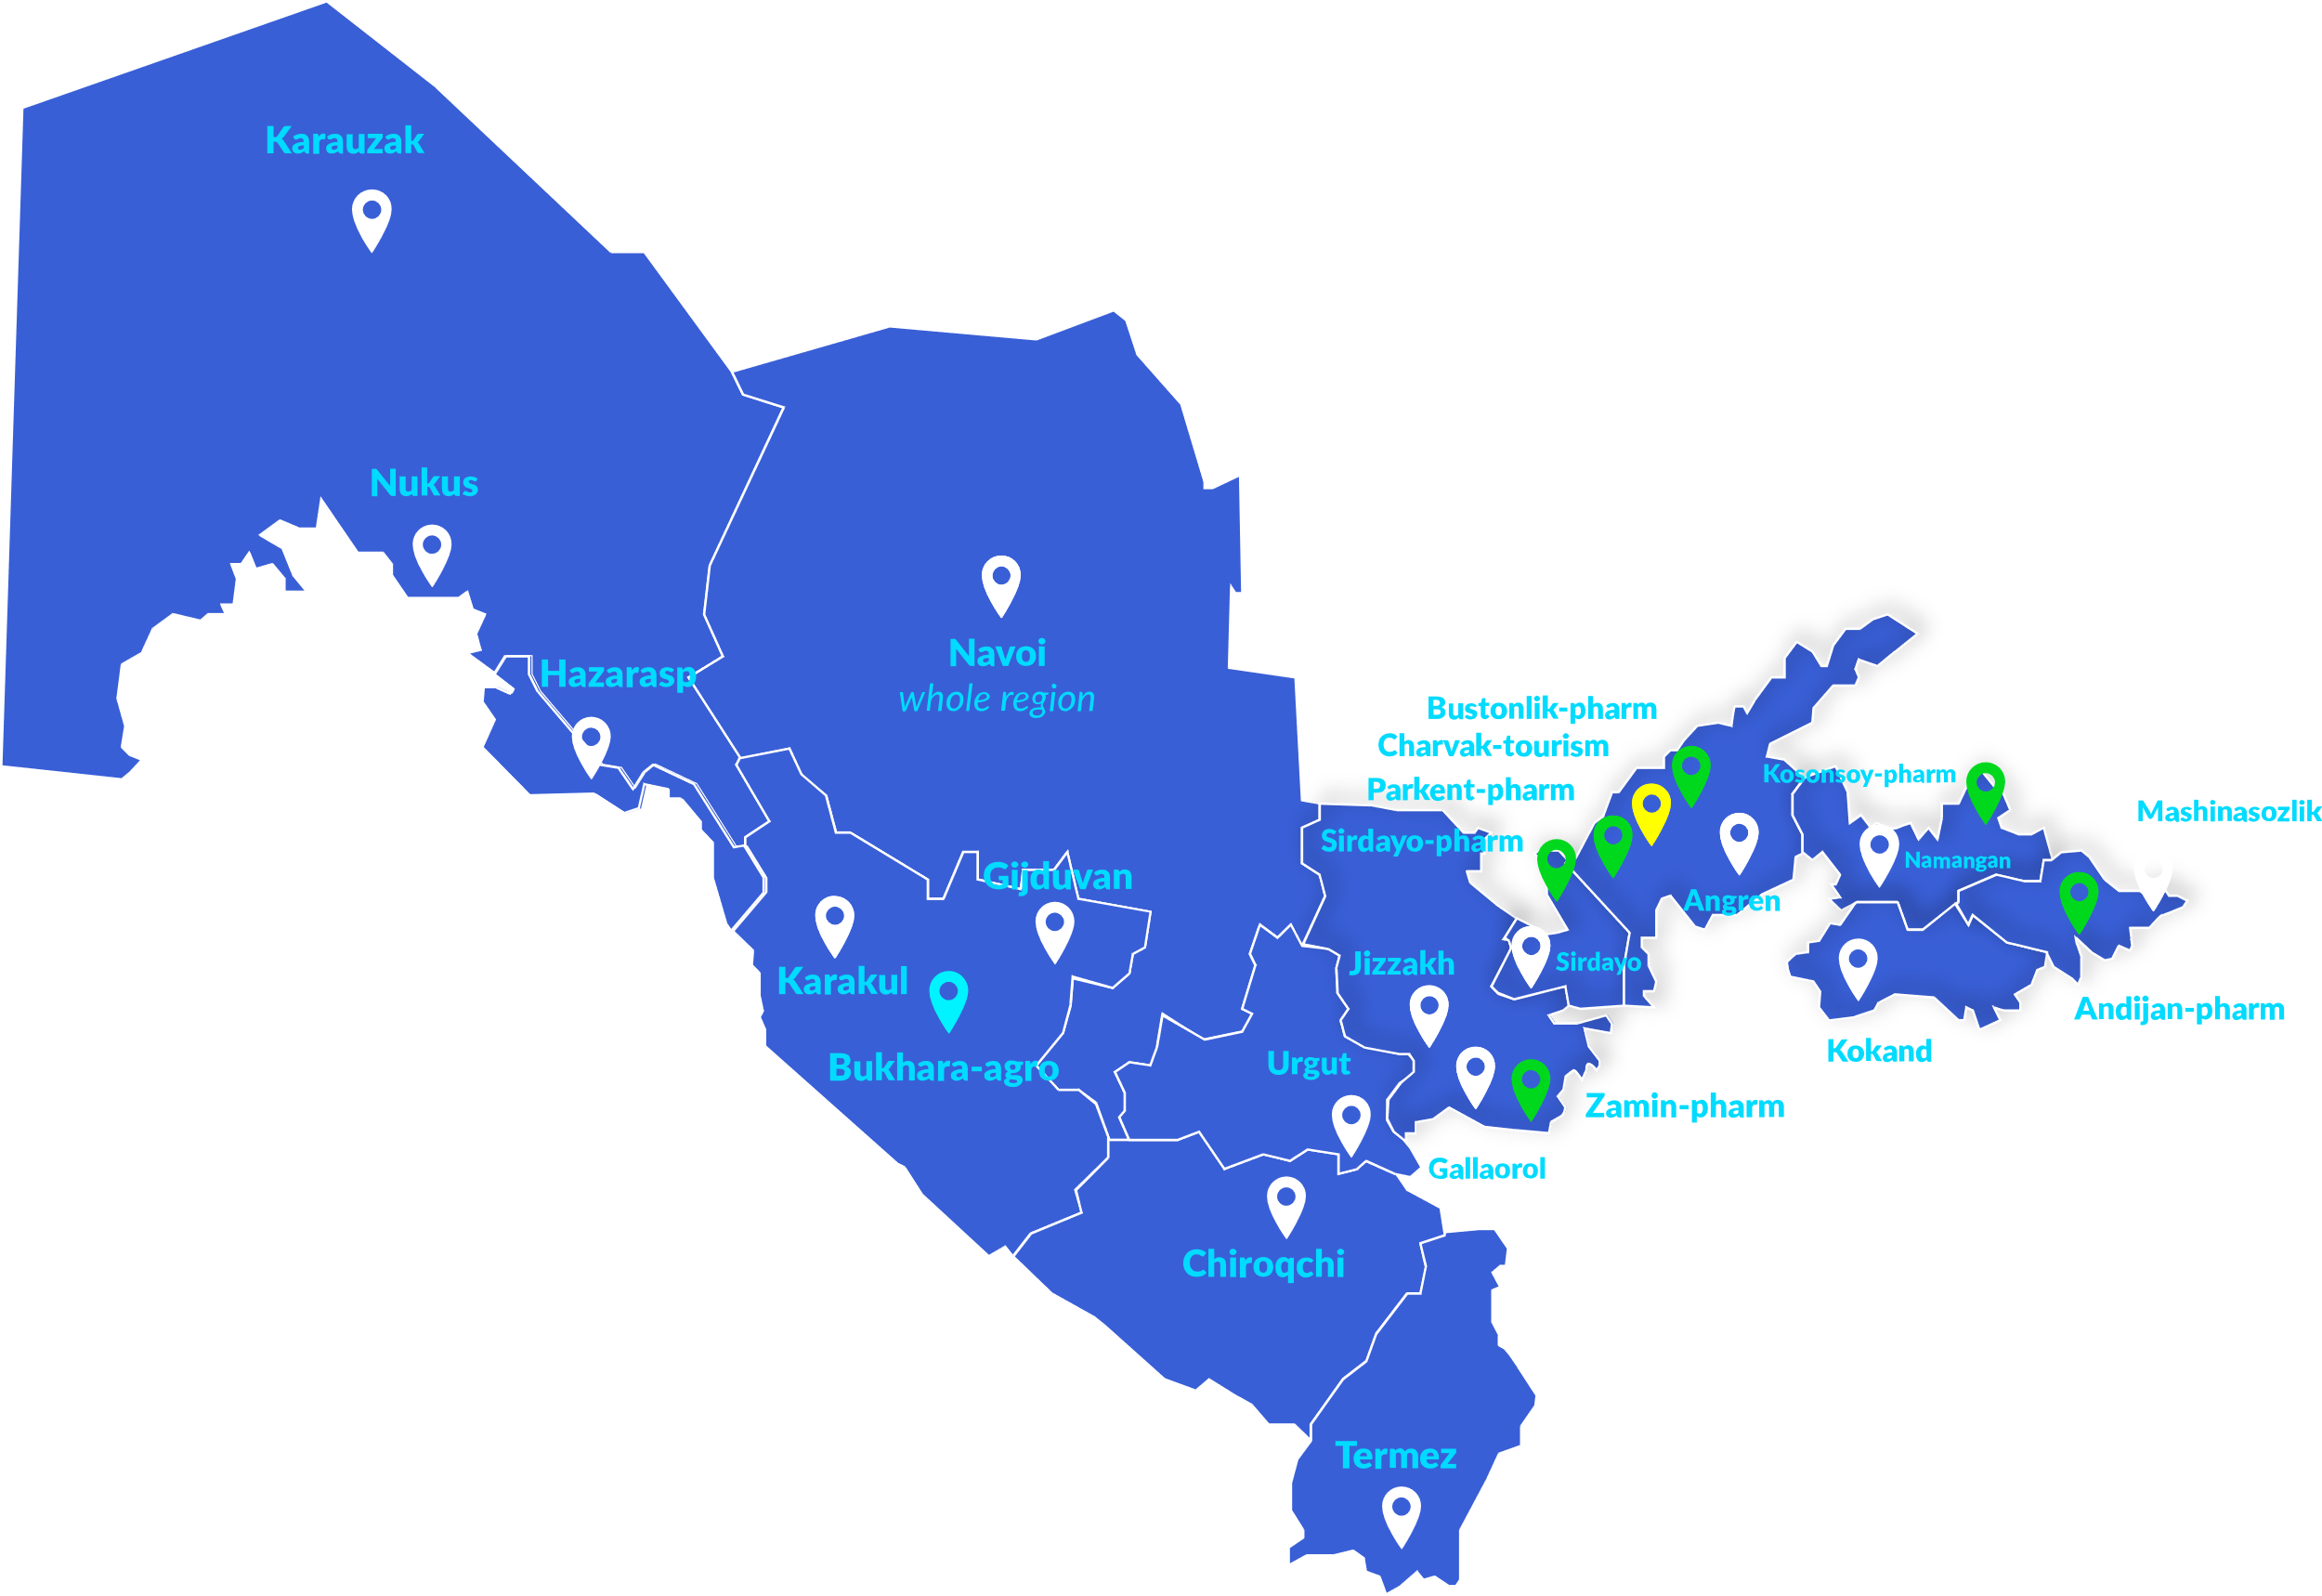











INCENTIVES FOR INVESTORS
ENTERPRISES WITH FDI* ARE EXEMPT FROM PAYING
TAX EXEMPTIONS FOR SEZ ENTERPRISES
Tax on property
Water usage tax
Land tax
Tourism FEZ
Tax on profit
Pharmaceutical FEZ
Industrial FEZ
Agricultural FEZ
5 years for investment of $3M – $5M
3 years for investment of $0,3M – $3M
5 years for investment of $3M – $10M
7 years for investment of $10M+
7 years for investment of $5M – $15M
*Except Tashkent and Tashkent region
10 years for investment above $15M
Not less than 15% should be the share of foreign investors in JSC and at least 33% in other cases.
tax on property
water usage tax
land tax
2
Customs duty exemption
years
3 years for investment of $0,3M – $3M
5 years for investment of $3M – $5M
7 years for investment of $5M – $10M
10 years for investment above $10M
For enterprises with at least 33% of investments importing property for own use

Slide 12





COMFORTABLE LIVING CONDITIONS
Gastronomic, cultural and sport tourism for appropriate price
A single person estimated monthly costs are $404
Investment visa option for you and family members
Family of four estimated monthly costs are
$1 459
90+ countries with
visa-free regime

Slide 13





Competitive business costs, incentives and comfortable living conditions
Irreversible reforms and strategic development
5
Reasons to invest
in Uzbekistan
Competitive
human capital
Accessibility of local
and regional markets
Developing Infrastructure and abundant natural resources

Slide 14

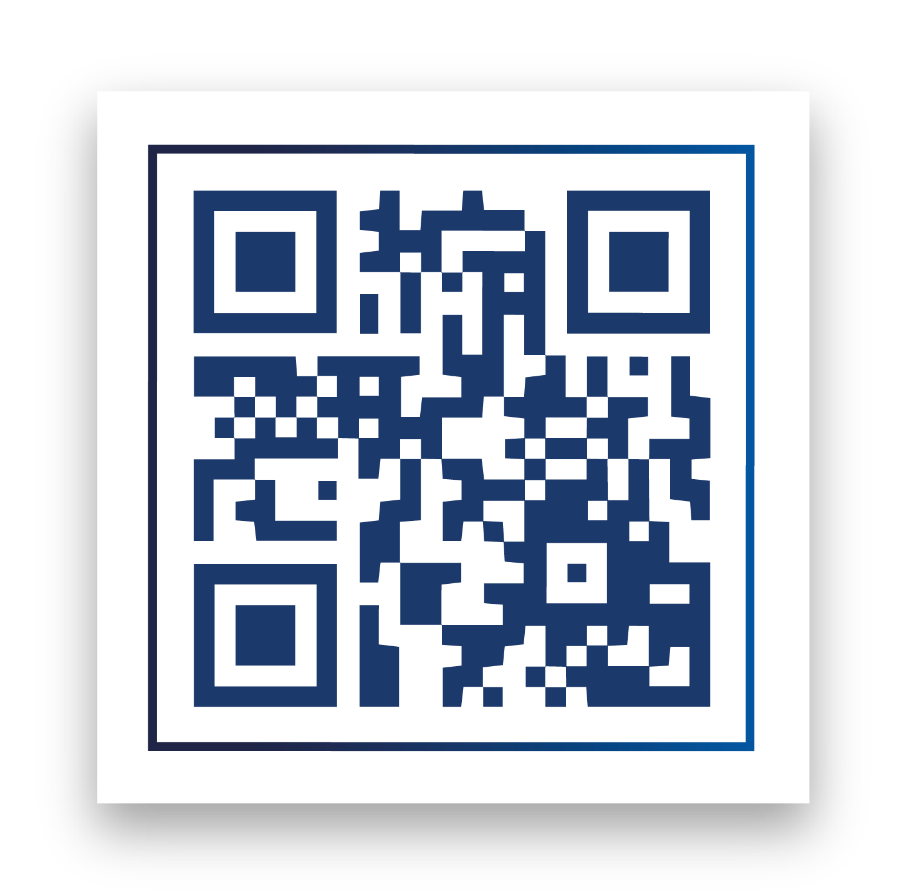
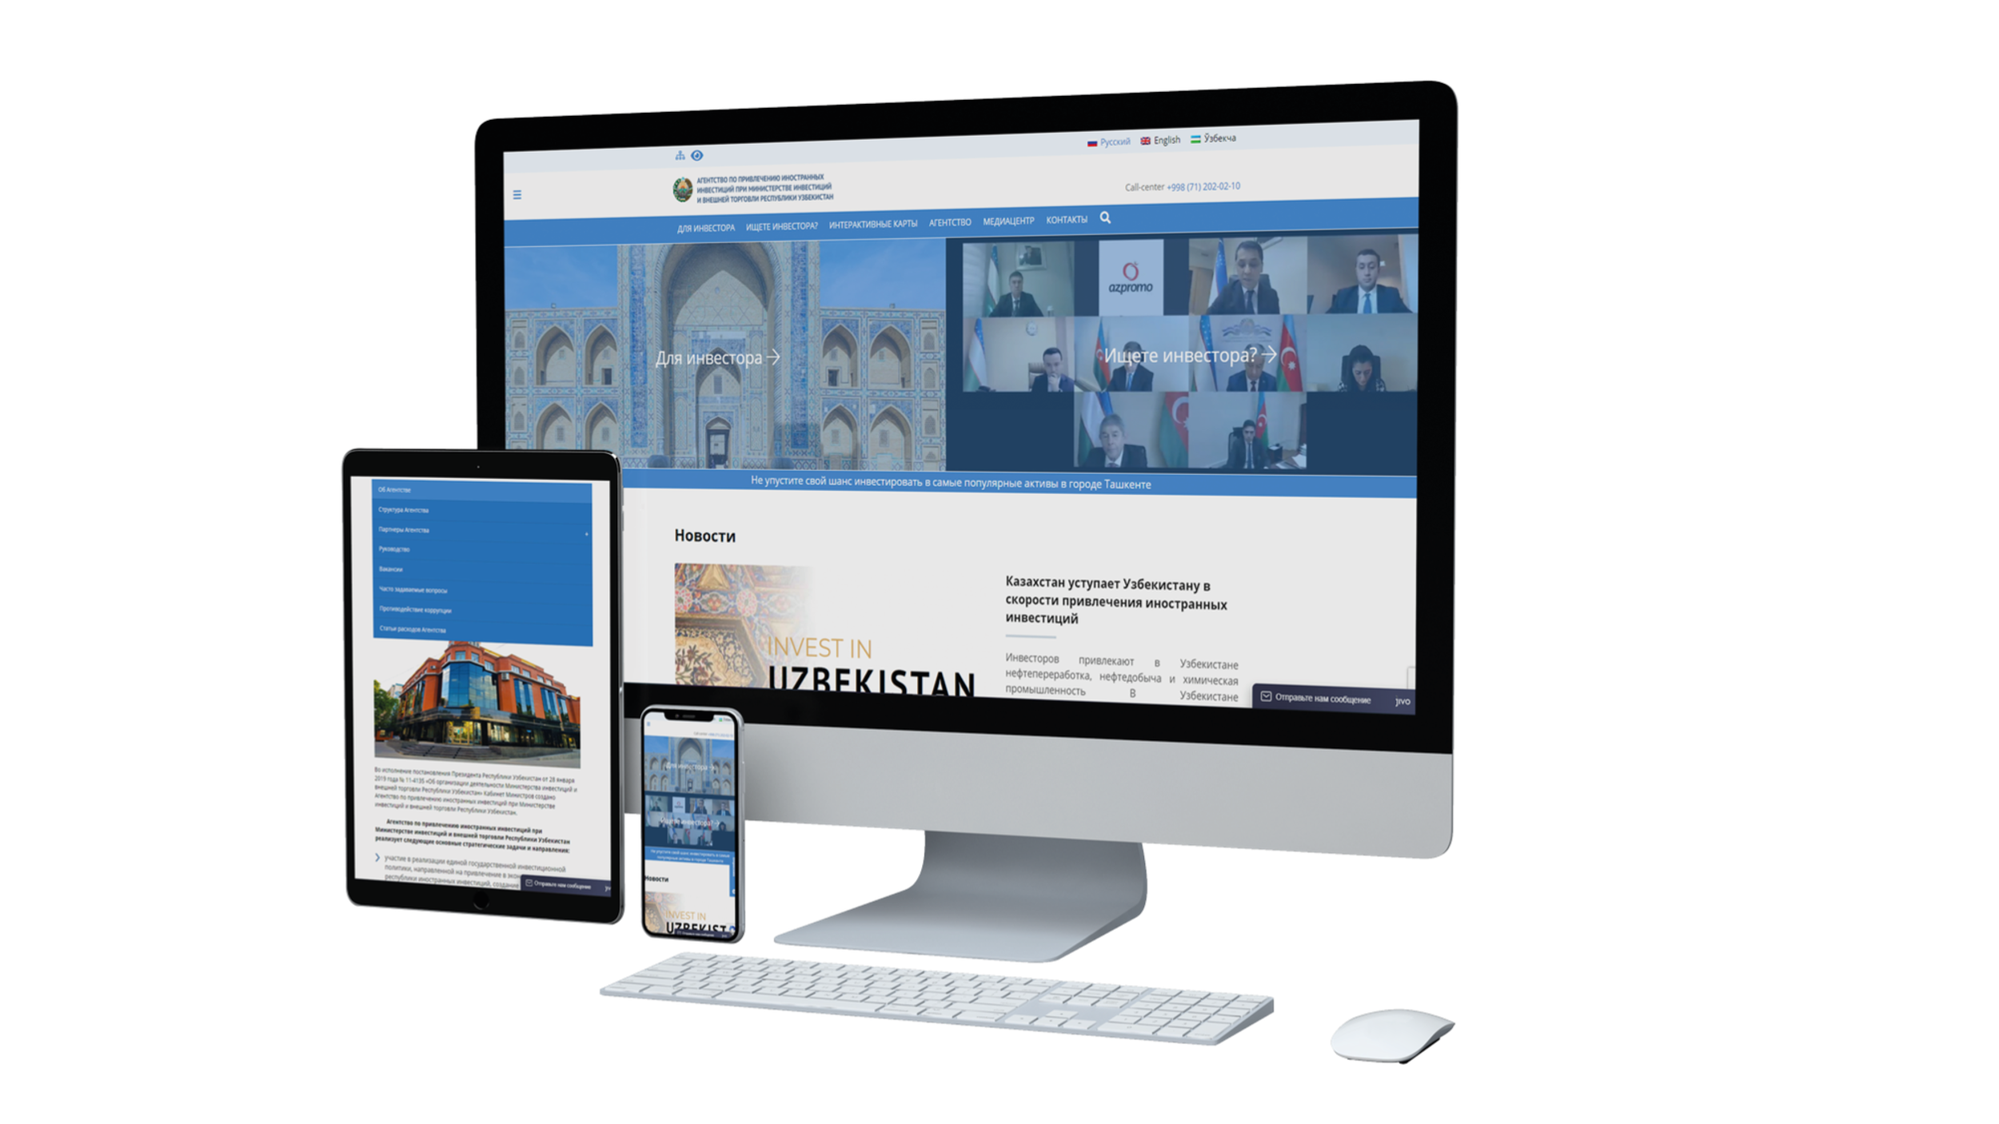
INVEST IN
UZBEKISTAN
+998 71 202 02 10
www.invest.gov.uz
uzipa@invest.gov.uz
34, Taras Shevchenko Street, Tashkent 100047, Uzbekistan

